Slide 1

Robust Graph Representation Learning with Adversarial Training
Haijing Zhang

Slide 2
Table of Content
Introduction
Motivation
Pro-GNN: Property-GNN
ARIEL: Adversarial Graph Contrastive Learning
Comparison & Analysis
Future work
Potential Improvement

Slide 3
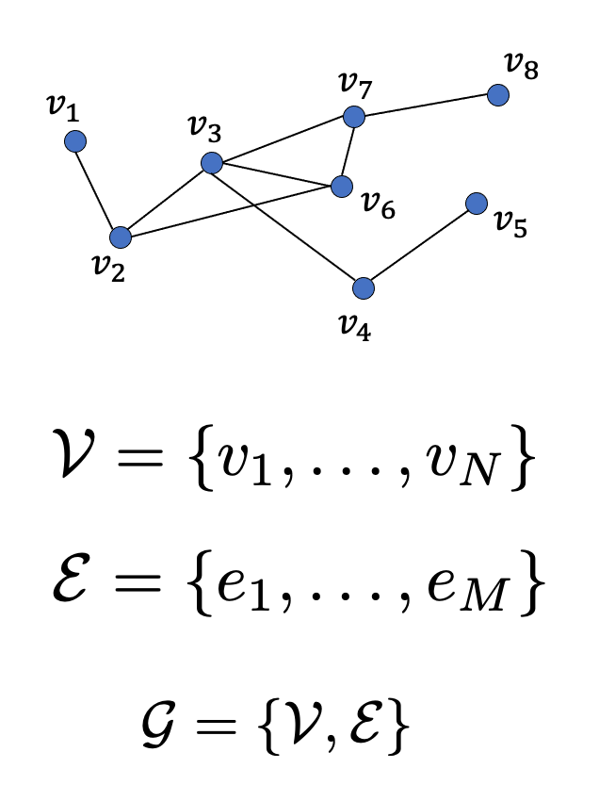
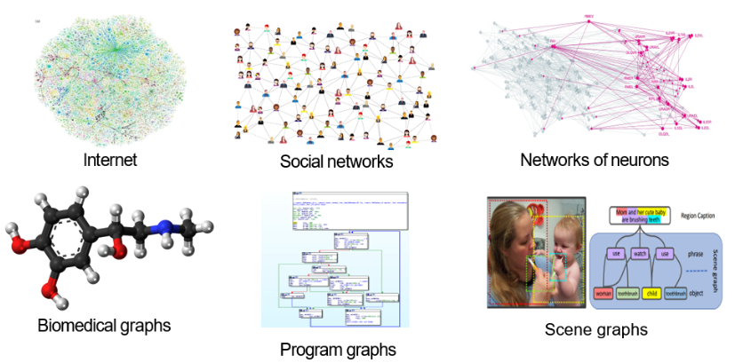
Introduction
Graph G(V, E): A structure used to model relationships and interactions (E) between entities (V)
https://cse.msu.edu/~mayao4/tutorials/aaai2020/

Slide 4
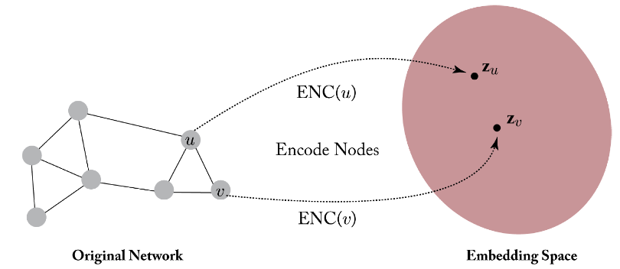
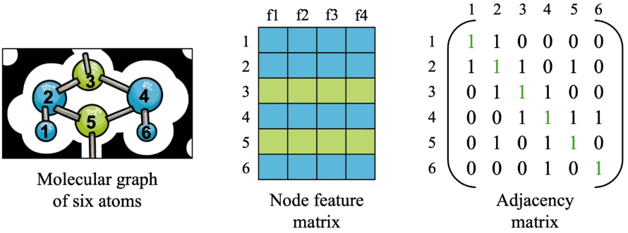

Graph Representation Learning
Goal: Learn an encoder $f$, mapping graph information into low-dimensional embeddings
Enable machine learning algorithms to work effectively with graphs for downstream tasks
G(A, X): Node embedding matrix H = $f$(A,X), graph representation R(H)
X
A
https://blog.reachsumit.com/posts/2023/04/intro-to-graph-representation-learning/
https://syedarizvi.com/blog/2024/gnn-basics/

Slide 5
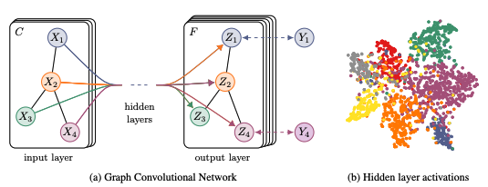

Graph Neural Network (GNN)
Powerful tools for graph representation learning
Message-passing scheme
Iteratively aggregating feature information from a node's neighbors
Node-level, edge-level, and graph-level task
Two-layer Graph Convolution Networks(GCN)
Thomas N. Kipf and Max Welling. 2017. Semi-Supervised Classification with Graph Convolutional Networks.

Slide 6
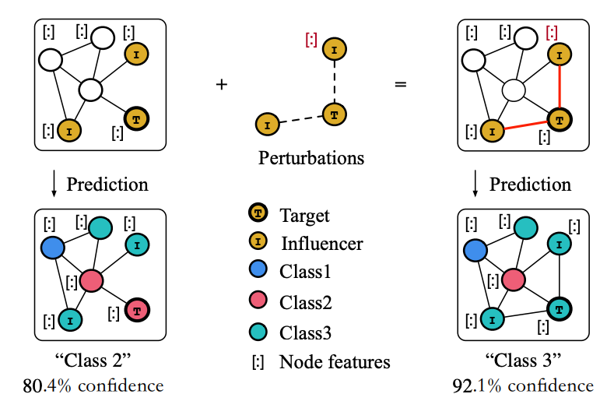
Motivation
Security and Privacy Problem: Many GNNs are vulnerable to adversarial attacks
Adversarial training enhances the robustness of GNNs
Two models:
Property-GNN (Pro-GNN): Graph properties
Adversarial Contrastive Learning (ARIEL): Graph contrastive learning
A Survey of Adversarial Learning on Graphs
arXiv:2003.05730

Slide 7
Pro-GNN: Property-GNN
Wei Jin, Yao Ma, Xiaorui Liu, Xianfeng Tang, Suhang Wang, and Jiliang Tang. 2020. Graph Structure Learning for Robust Graph Neural Networks

Slide 8
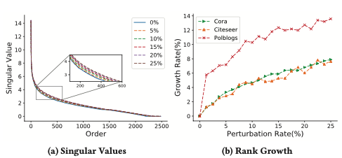
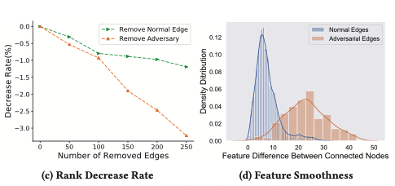
Graph Structure Learning
Graph structure properties: low-rank, sparsity, and feature smoothness
Adversarial attacks are likely to violate these graph properties
Pro-GNN: Reconstruct a clean graph & Update GNN’s parameter to improve node classification performance for unlabeled nodes
An illustrative example on the property changes of the adjacency matrix by adversarial attacks

Slide 9
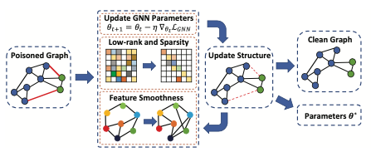
Overall Framework of Pro-GNN
Given G(A,X) and partial node label Y with A poisoned by adversarial edges and feature matrix X unperturbed
Normal Edges in black and adversarial edges in red
Simultaneously learn a clean graph structure and the GNN parameters θ

Slide 10




Objective Function
Low rank & Sparsity, Feature Smoothness, GNN
S: Clean adjacency matrix
$\hat{L}$: Normalized Laplacian matrix
Jointly learn the GNN model and the new adjacency matrix

Slide 11
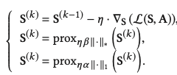

Optimization Algorithm
Alternate a gradient descent step and a proximal step
Update $θ$: Freeze S, GNN optimization
Update S: Freeze $θ$, Incremental Proximal Descent method
Raguet et al. 2013. A generalized forward-backward splitting
Richard et al. 2012. Estimation of simultaneously sparse and low-rank matrices

Slide 12
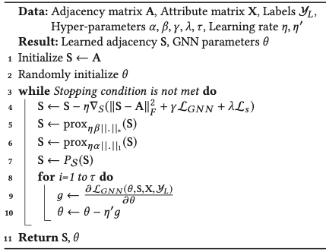
Pro-GNN Training Algorithm
Projection operation P_{S}(S)
S_{ij} ∈ [0,1], project S_{ij} < 0 to 0 and S_{ij} > 1 to 1

Slide 13
Experimental Settings
Four benchmark datasets | Three citation graphs: Cora, Citeseer, Pubmed One blog graph: Polblogs
Baselines –Node classification | GCN, GAT, RGCN, GCN-Jaccard, GCN-SVD, Pro-GNN-fs
Parameter settings | 10% of nodes for training 10% of nodes for validation 80% of nodes for testing The average performance of 10 runs Different perturbation rate 0–25%

Slide 14
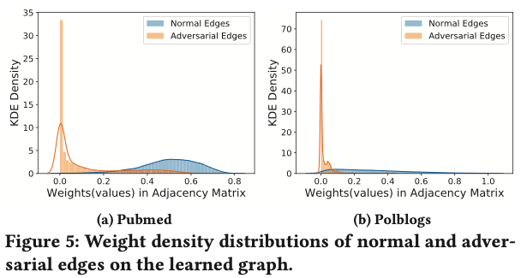
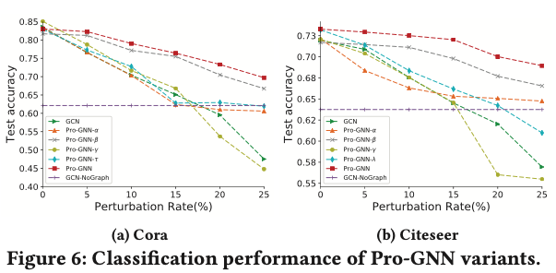
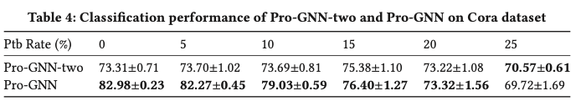
Main Results
Defense performance: Consistently outperform baseline models
Non-targeted attack: Metattack
Targeted attack: Nettack
Random attack
Importance of Graph Structure Learning
Weights of adversarial edges are much smaller than those of normal edges in S
Learn useful structural information on heavily poisoned graph 25%
Ablation Study
Regularizer: Pro-GNN-α, Pro-GNN-β(nuclear norm), Pro-GNN-γ and Pro-GNN-λ
Two-Stage vs One-Stage

Slide 15
ARIEL: Adversarial GRaph ContrastIvE Learning
Shengyu Feng, Baoyu Jing, Yada Zhu, and Hanghang Tong. 2024.
ArieL: Adversarial Graph Contrastive Learning. https://doi.org/10.1145/3638054

Slide 16
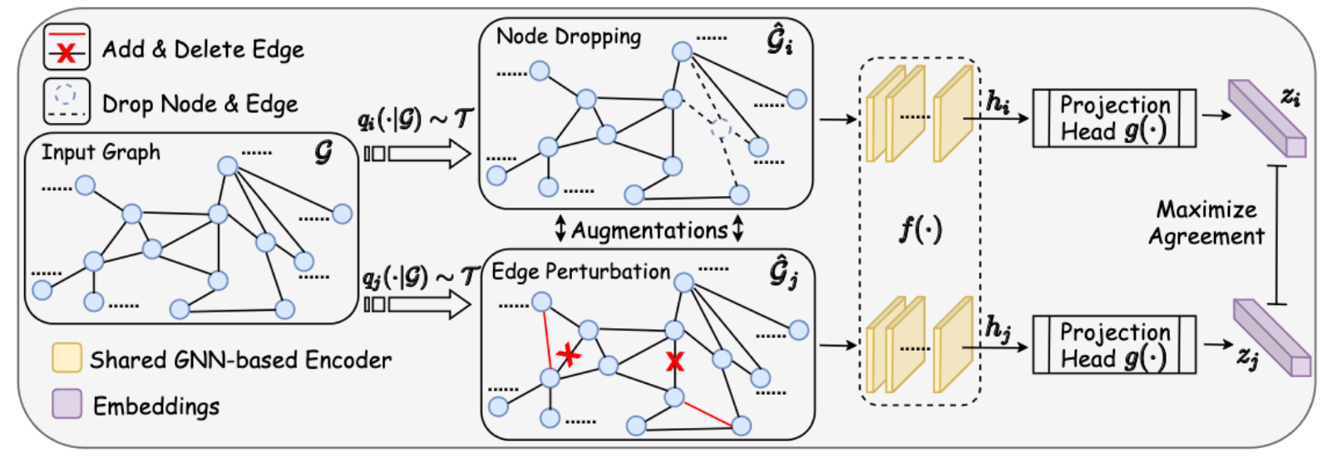
Graph Contrastive Learning
An effective self-supervised method in graph representation learning without relying on labeled data
Key idea: Create positive and negative pairs, and then maximize the similarity among positive pairs and minimize the similarity with negative pairs
Yuning You . 2020. Graph contrastive learning with augmentations.

Slide 17
Adversarial GRaph ContrastIvE Learning
An adversarial view as a form of data augmentation: Hard enough for the model to discriminate & maintain the desired properties
Information regularization to stabilize the training
Bridge the gap between node-level and graph-level contrastive learning
Better performance and higher robustness

Slide 18
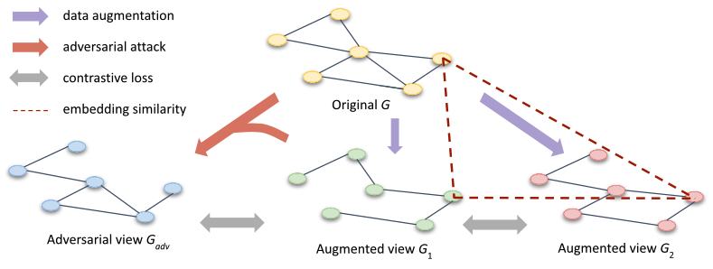
Overview of ARIEL Framework
Objectives:
Minimize the contrastive loss between the two augmented views
Minimize the contrastive loss between the adversarial view and its corresponding augmented view
Apply the information regularization to maintain stability

Slide 19



InfoNCE loss
$Contrastive learning loss L_{k}$: Maximize the lower bound of the mutual information $I(x;x^{+})$ between two random variables
Positive pair $\left(x,x^{+}\right); k negtive samples of x$
Density ratio $g$(.) with the property $g$(a.b) $∝$ $\frac{p(a|b)}{p(a)}$

Slide 20
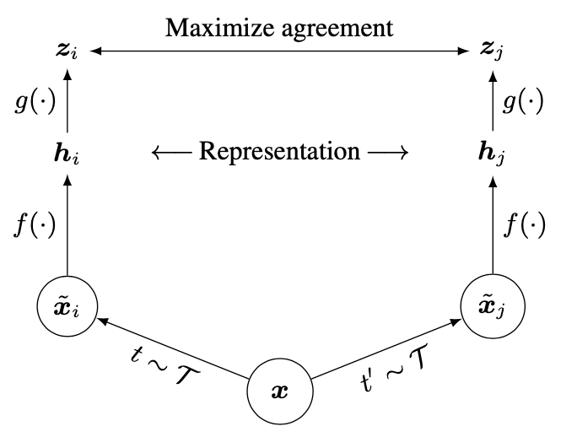

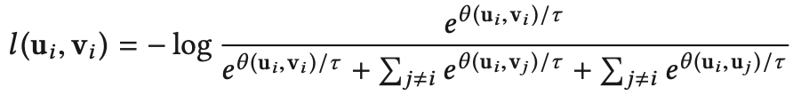

Node-level Contrastive Learning
SimCLR framework
A variant of InfoNCE loss: symmetrically defined
Random edge-dropping and feature masking
Define θ (u, v) to be the similarity function
$Density ratio g\left(x,x^{+}\right)= e^{θ(x;x^{+})/τ}$; Temperature parameter $τ$
Chen et al. 2020. A simple framework for contrastive learning of visual representations.

Slide 21





Adversarial training
Goal: $G_{adv}={{\arg{max}}_{G^{′}}L}_{con}\left(G_{1}, G^{′}\right)$, G′ = {A′, X′} , constrained by $∆_{A}$ and $∆_{X}$
Projected gradient descent (PDG) attack
Perturbed adjacency matrix: $A_{adv}=A+C$ $∘$ $L_{A}$ , $C= \overline{A}−A$, $\overline{A}=1_{n xn}$ - $I_{n} −A$
$L_{A }∈ {\left\{0,1\right\}}^{n x n}:$ Whether or not to be modified; Symmetric matrix
Perturbed feature matrix: $X_{adv}=X+ L_{X}$
Relax $L_{A}$ to convex hull ${\tilde{L}}_{A}∈ {\left\{0,1\right\}}^{n x n}$ , $S_{A}= \left\{{\tilde{L}}_{A} | \sum_{i,j}{{\tilde{L}}_{A} ≤∆_{A}, }{\tilde{L}}_{A} ∈ {\left[0,1\right]}^{n x n}\right\}$
$S_{X}= \left\{L_{X}| {\left\|L_{X}\right\|}_{∞}{≤δ_{X},L_{X}∈R}^{n x d}\right\}$
Xu et al. 2019. Topology attack and defense for graph neural networks: an optimization perspective.

Slide 22

Adversarial Graph Contrastive learning
Adversarial contrastive loss: Contrastive loss between G₁ and G_{adv}
Subgraph sampling G_{s}: Avoid heavy computation; Increase randomness
Curriculum learning: For every T epoch, $ε$₁ is multiplied by a weight γ, γ > 1
$ε$₁ > 0: The adversarial contrastive loss coefficient

Slide 23

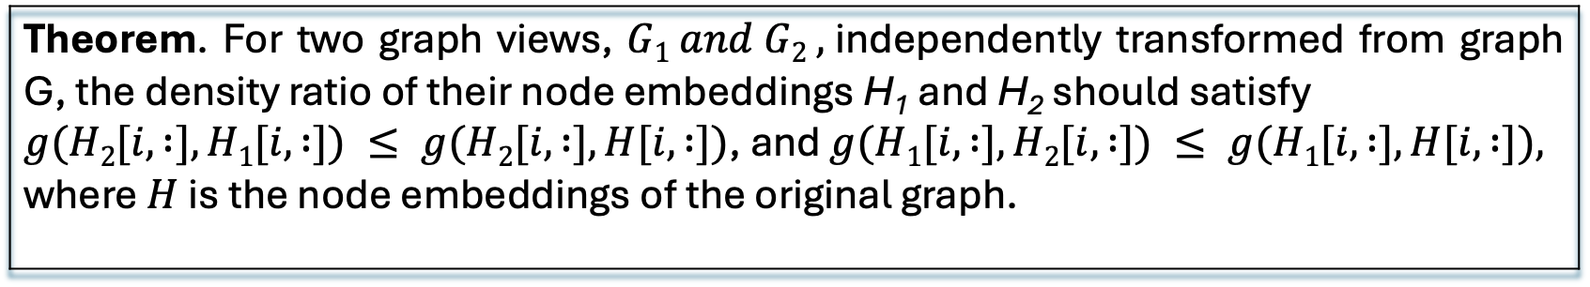
Information Regularization
Goal: Address training collapse and regularize the instance similarity
The loss function of Ariel:
Theorem. For two graph views, $G1 and G2 ,$independently transformed from graph G, the density ratio of their node embeddings H₁ and H₂ should satisfy $g(H2[i, :], H1[i, :]) ≤ g(H2[i, :], H[i, :])$, and $g(H1[i, :], H2[i, :]) ≤ g(H1[i, :], H[i, :]),$ where $H$ is the node embeddings of the original graph.
$ε$₂ > 0 controls the strength of the information regularization

Slide 24
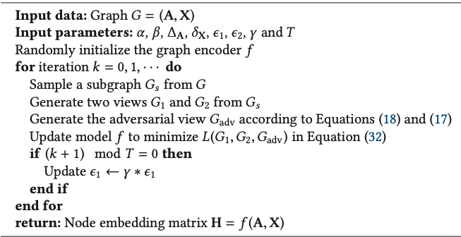


Algorithm of Ariel
1
2
3
1
2
3

Slide 25
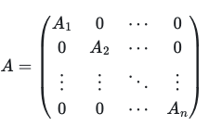

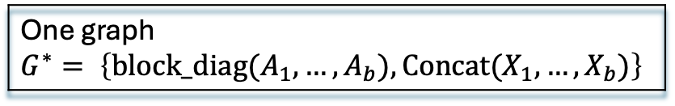
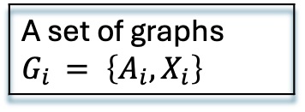
Extension to Graph-level contrastive learning
A set of graphs $G_{i }= \left\{A_{i}, X_{i}\right\}$
Combined
One graph $$G^{∗}= \left\{block_diag(A_{1}, …, A_{b}), Concat(X_{1},…, X_{b})\right\}$$
A batch of graphs B = {G₁, · · · , G_{b} }
Node dropping, Subgraph sampling
the augmentation of each graph B⁺ = {G₁⁺, · · · ,G_{b}⁺}
Edge perturbation, Feature masking
The objective of adversarial graph contrastive learning
The final loss function of ARIEL for the graph-level contrastive learning

Slide 26
Experiments
Evaluation: Node/Graph classification task; Robustness node classification task on attacked graphs
Node-level contrastive leaning | Datasets: Eight datasets--Cora, CiteSeer, Amazon-Computers, Amazon-Photo, Coauthor-CS, Coauthor-Physics, Facebook, LastFM Asia
 | Baseline: Seven graph contrastive learning methods--DeepWalk, DGI, Robust DGI (RDGI), GMI, MVGRL, GRACE, GCA; Two supervised methods—GCN, Graph Attention Network (GAT).
Graph-level contrastive learning | Datasets: TUDataset-the biochemical molecules graphs NCI1, PROTEINS, DD, and MUTAG
 | Baseline: Graph kernel methods-- graphlet kernel (GL), Weisfeiler-Lehman sub-tree kernel (WL), deep graph kernel (DGK); Unsupervised GRL methods-- node2vec, sub2vec, graph2vec, InfoGraph, GraphCL
Evaluation protocol | 10% nodes/graphs for training, 10% nodes/graphs for validation, and 80% for testing Evaluation metric: Accuracy Poisoning attack: Metattack, randomly mask out 20% of the node features and use Metattack to perturb 20% of the edges

Slide 27
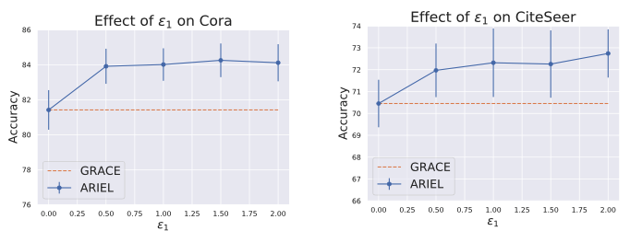
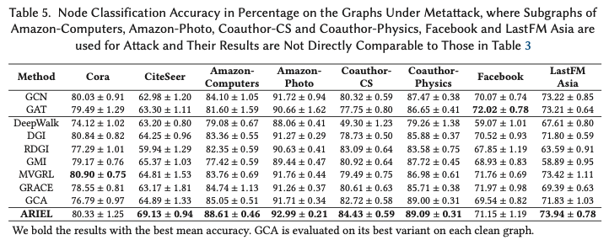
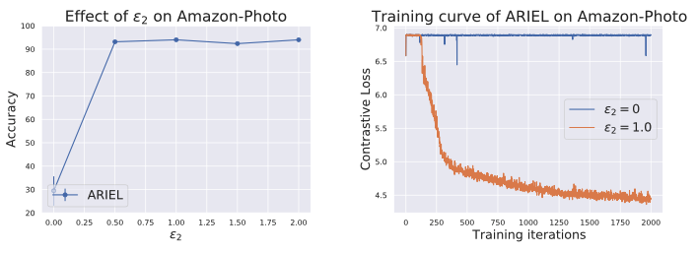
Main Results
Classification task
Node: Consistent improvement and more stable performance
Result under attack
More robust than the previous graph contrastive learning methods in the face of an adversarial attack.
Ablation Study
Adversarial contrastive loss coefficient $ε_{1}:$ $ε_{2}$ = 0, $ε_{1}$ 0 ~ 2
Adversarial contrastive loss coefficient 𝜖_1: 𝜖_2 = 0, 𝜖_1 0 ~ 2
Graph: Stronger performance
ARIEL has a better data augmentation strategy
Information regularization $ε_{2}$: $ε_{1}$ = 0, $ε_{2}$ 0 ~ 2
Information regularization 𝜖_2: 𝜖_1 = 0, 𝜖_2 0 ~ 2
Training analysis
Better scalability
Subgraph the sampling reduces the computation cost

Slide 28
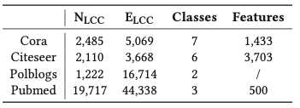
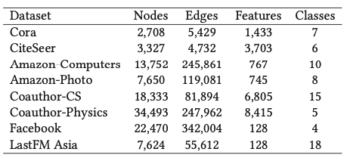
Comparison & Analysis
Pro-GNN | ARIEL
Graph(Node-level) representation learning with adversarial training, Better downstream task (classification) performance, Robust GNNs against adversarial attack
Structure learning: Graph properties Graph sanitization | Contrastive learning: Graph data-augmentation Combine graph structure learning and contrastive learning More robust and informative graph representation
Semi-supervised learning | Unsupervised learning: Without labeled data More flexible and scalable
Adversarial training: Edge perturbation, Node feature unchanged | Adversarial training: Edge & Node feature perturbation
Node-level representation | Node-level & graph-level representation
Small size datasets | Diverse, larger datasets
Parameter analysis | Parameter analysis and computational cost and training time; NVIDIA Tesla V100S GPU with 32 G memory

Slide 29
Potential Improvement
Pro-GNN: Graph structure learning
Node features perturbation
Other graph properties: Clustering coefficient, degree distribution…
ARIEL: Adversarial graph contrastive learning
Contrastive learning methods: Momentum encoder (MoCo), adaptive Contrastive learning…
Adversarial graph contrastive learning: Negative mining strategy
Reduce computation cost: Select some anchor node

Slide 30
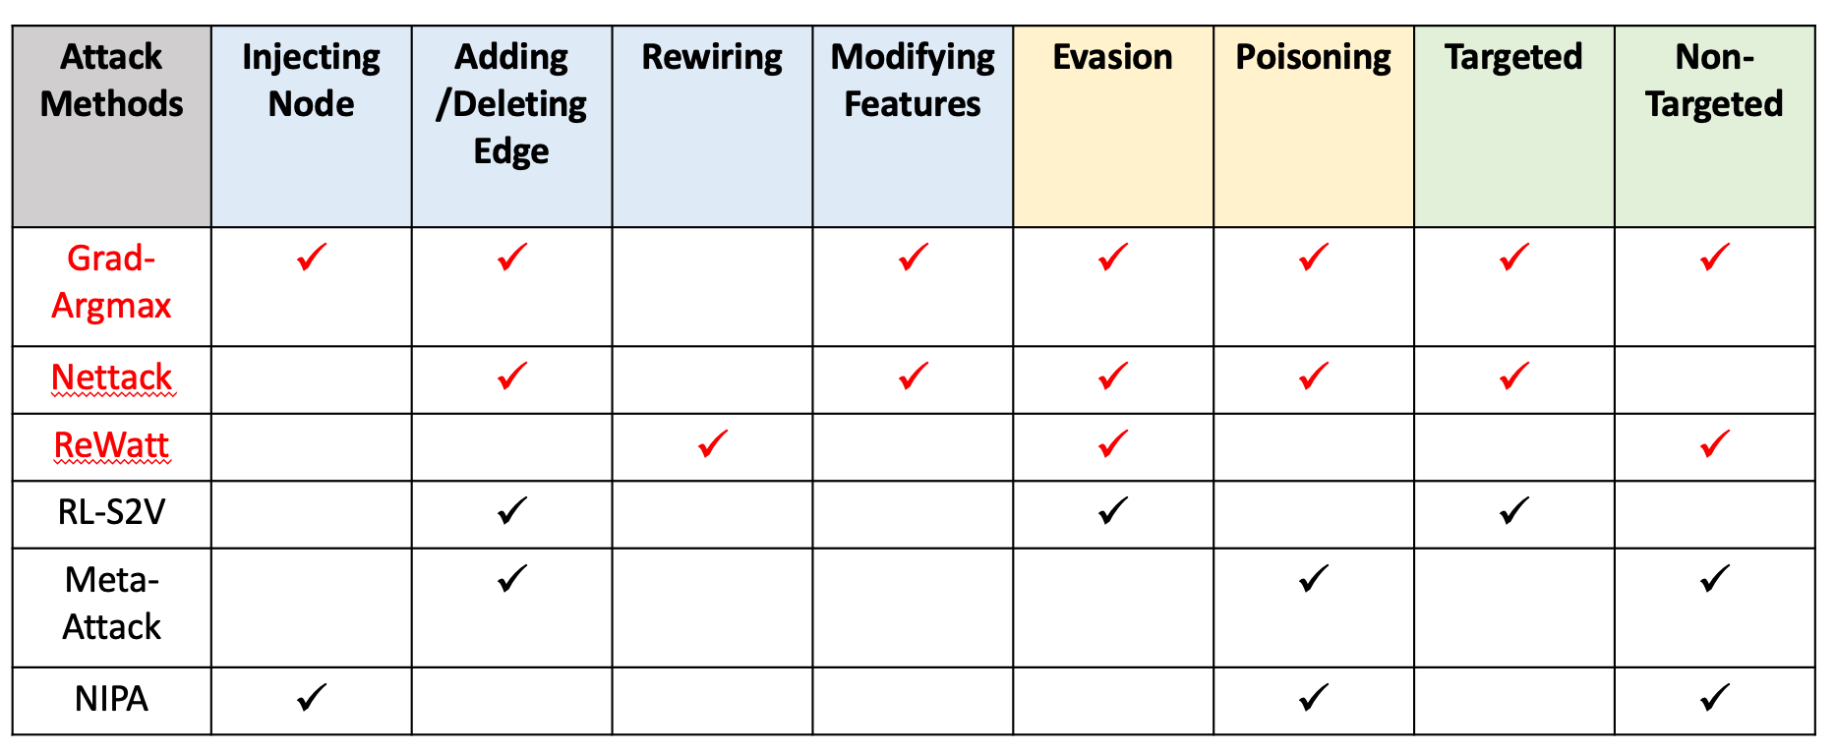
Potential Improvement
Adversarial Training:
Generating adversarial view
Perturb graph data
Graph encoder: Attention Mechanism (GAT), GraphSAGE…

Slide 31
Future Work
The trade-off between Graph representation learning and Privacy & security
Robust GNNs in customer segmentation and custom life value
GAN and Graph Representation Learning

Slide 32

Q & A

Slide 33

Thank you!

